Slide 1
Churn Prediction
Course No: CSE 4120
Course Title: Technical Writing and Seminar
Supervised By,
Dr. K. M. Azharul Hasan
Professor
Department of CSE, KUET
Sunanda Das
Assistant Professor
Department of CSE, KUET
Presented By,
Doniel Tripura
Roll : 1907121
Department of CSE, KUET
​

Slide 2
Publication Details
Table 1: Publication Details
Title | Author | Source | Publisher | Published Year
Churn Prediction using Neural Network based Individual and Ensemble Models. | Mehpara Saghir, Zeenat Bibi, Saba Bashir, Farhan Hassan Khan | 16th International Bhurban Conference on Applied Sciences & Technology (IBCAST). | IEEE Xplore | 2019
Customer Churn Prediction Using Machine Learning. | Dr. Varsha Agarwal, Dr. Durgaprasad Gangodkar, Shwetkranti Taware, Dr. ALN Rao, Suman Avdhesh Yadav, V K Srivastav | 2nd International Conference on Technological Advancements in Computational Sciences (ICTACS). | Various Conferences and journals | 2009
Customer churn prediction by hybrid neural networks. | Chih-Fong Tsai, Yu-Hsin Lu | Expert Systems with Applications (Volume 36) Journal Paper | Elsevier | 2022

Slide 3

Outline
Introduction
Literature Review
Methodology
Result Analysis
Comparative discussion
Recommendation& findings
Conclusion
References

Slide 4
Introduction
Churn refers to the phenomenon where customers or subscribers cease their relationship with a company or service provider. This could involve
1. Canceling a subscription,
2. Discontinuing the use of a product or service, or
3. Switching to a competitor.
Churn is a critical metric for businesses across various industries, as it directly impacts revenue and profitability.

Slide 5
Introduction(Cont.)
Churn prediction is the process of using historical data and predictive analytics techniques to forecast which customers are at risk of churning in the future.
Customer churn prediction is a critical aspect of business operations, particularly in industries like telecom, banking, retail, subscription-based services and others, where customer retention directly impacts profitability and growth.
In this presentation, we will delve into three distinct approaches to customer churn prediction, analyzing their methodologies, results, and implications.

Slide 6
Introduction(Cont.)
Churn prediction is crucial for businesses to maintain profitability, foster customer loyalty, and stay competitive in today's dynamic marketplace. By identifying and addressing potential churn factors proactively, businesses can minimize customer attrition and maximize long-term success.
1. Retaining Customers
2. Revenue Protection
3. Resource Optimization
4. Competitive Advantage
5. Data-Driven Decision Making

Slide 7
Outline
Introduction
Literature Review
Methodology
Result Analysis
Comparative discussion
Recommendation& findings
Conclusion
References

Slide 8
Literature Review
Different Machine learning models can be used for churn prediction [5], such as LR, RF, SVM, ADAB, XGB, DT, NB, KNN.
Artificial Neural Network (ANN) is a useful tool to predict customer churn, as demonstrated in [7].
Rodan [6] has introduced a six-step data mining technique to predict customer churn, which incorporates some traditional techniques.

Slide 9
Literature Review(Cont.)
H. Karamollaoğlu [3], have explored the use of Logistic Regression (LR) and Naïve Bayes (NB) models for churn prediction for both balanced and unbalanced dataset.
Mehpara Saghir [1] has evaluated individual and ensemble ANN-based classifiers, and proposes using a Bagging-ANN ensemble classifier for improved accuracy.
Researchers [2] have proposed using a hybrid neural network, which combines ANN and self-organizing maps (SOM), to improve the accuracy of churn prediction.

Slide 10
Outline
Introduction
Literature Review
Methodology
Result Analysis
Comparative discussion
Recommendation& findings
Conclusion
References

Slide 11
Methodology
Evaluation of existing individual and ensemble classifier which utilizes Bagging with Neural Network. [1]
1. Data Acquisition
2. Data Pre-processing
3. Classifer Training and Testing
4. Ensemble Classifier
3.1 Deep Learning
3.2 Natural Nets
3.3 AutoMLP
4.1 Bagging
4.2 Majority Voting
4.3 AdaBoost
Figure 1.1: Methodology [1]

Slide 12
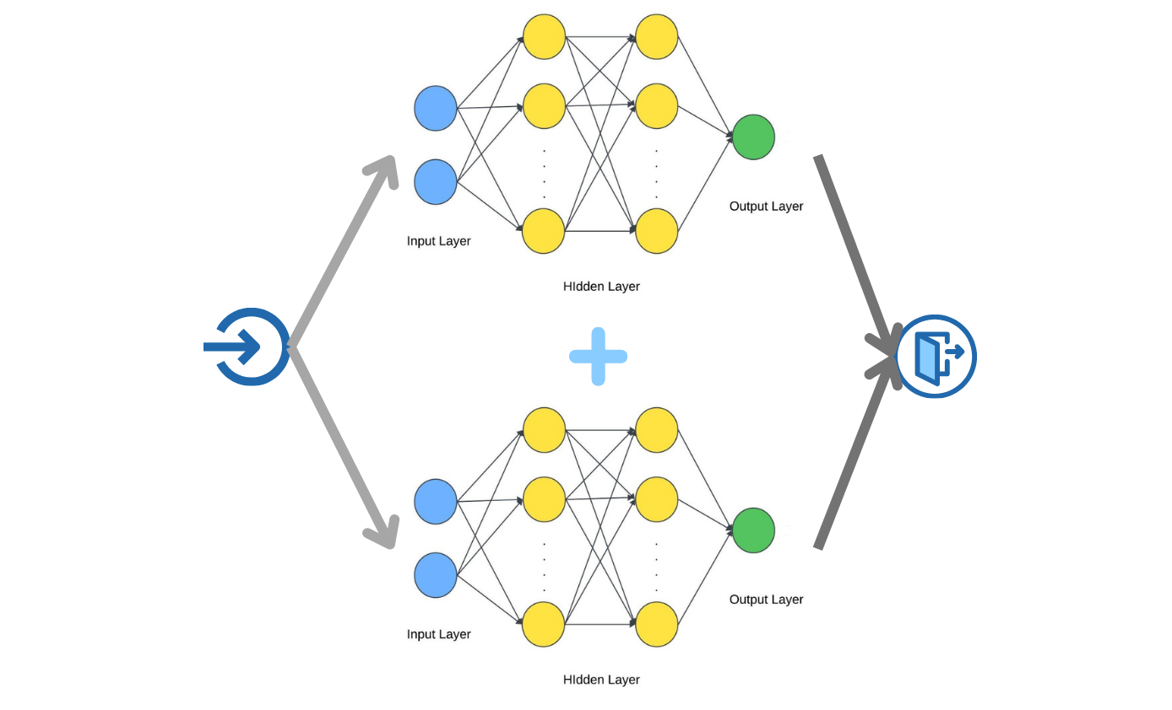
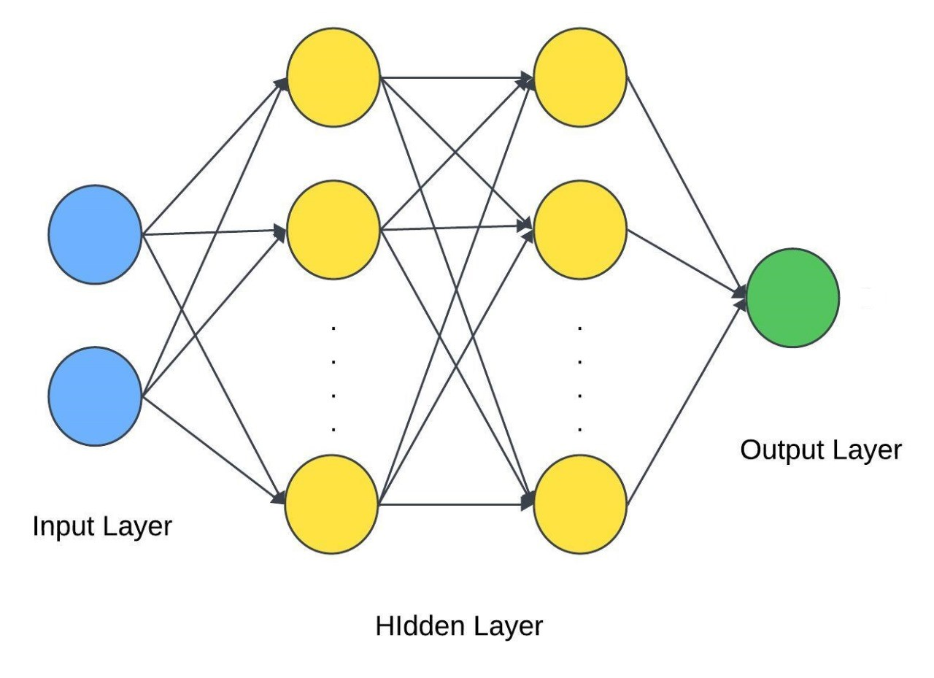
Methodology(Cont.)
Figure 1.2: Individual Classifier
Figure 1.3: Ensemble Classifier

Slide 13
Methodology(Cont.)
Evaluation of two hybrid models by combining two different neural network techniques. [2]
1. Data set Collection
2. Model Development
2.1 ANN+ANN
2.2 ANN+SOM
Figure 2.1: Methodology [2]

Slide 14
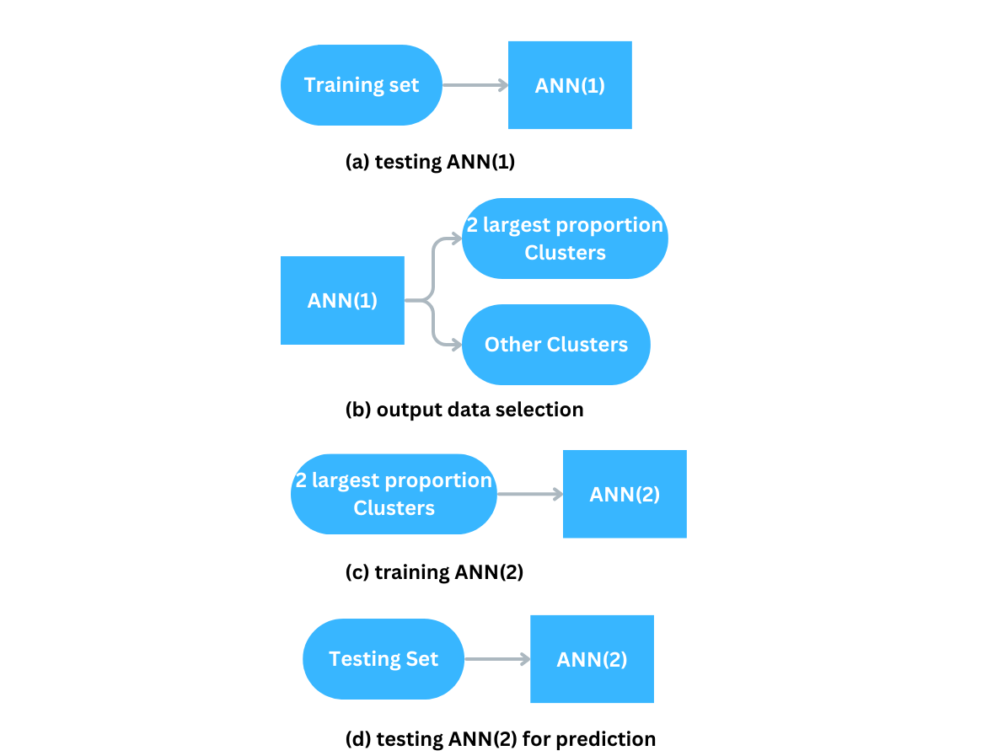
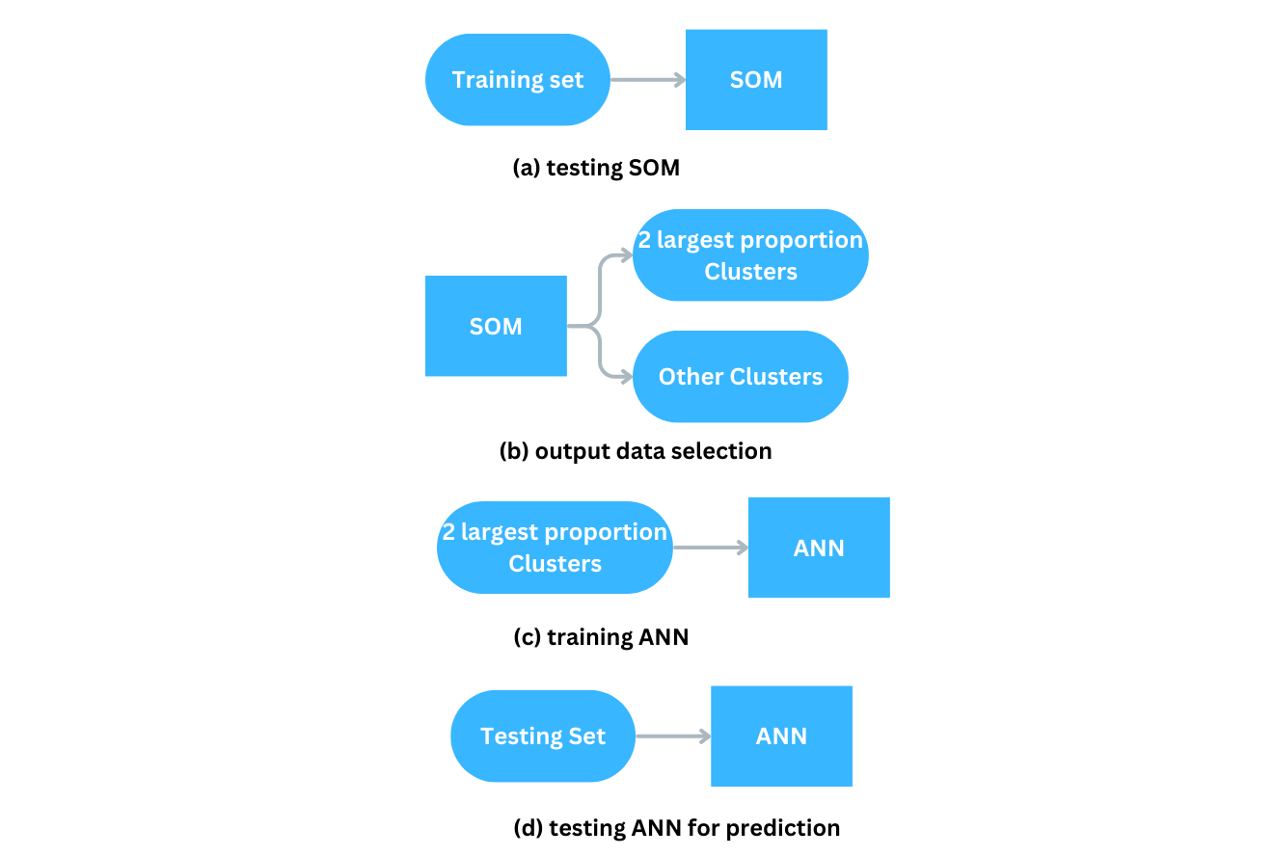
Methodology(Cont.)
Figure 2.2: ANN+ANN
Figure 2.2: Self-Organizing Map+ANN

Slide 15
Methodology(Cont.)
Probabilistic predictions using machine learning models such as Logistic Regression (LR) and Naive Bayes (NB). [3]
1. Data Set Collection
2. Data Pre-processing & Encoding
3. Classifer Training and Testing
3.1 Logistic Regression
3.2 Naïve Bayes
Figure 3.1: Methodology [3]

Slide 16
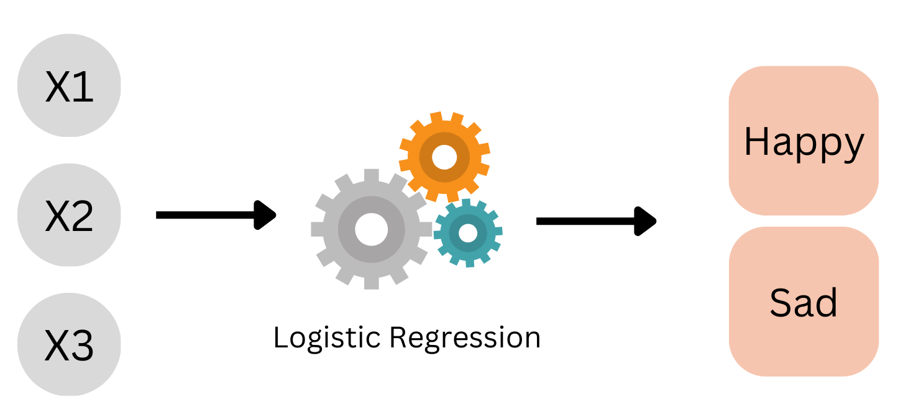
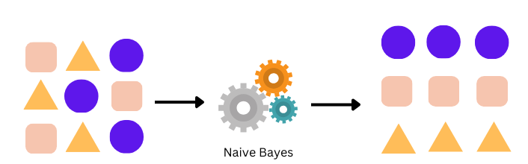
Methodology(Cont.)
Figure 3.2: Logistic Regression
Figure 3.3: Naïve Bayes

Slide 17
Outline
Introduction
Literature Review
Methodology
Result Analysis
Comparative discussion
Recommendation& findings
Conclusion
References

Slide 18
Result Analysis
Table 2: Result Analysis
Paper No | Performing Model |  | Accuracy | Precision | Recall | F Measure
1 | Individual Classifier | DL | 91.42 | 83.035 | 81.655 | 82.34
 |  | NN | 93.94 | 89.955 | 84.415 | 87.10
 |  | AutoMLP | 93.91 | 89.445 | 84.920 | 87.12
 | Ensemble Classifier | Bagging DL | 91.51 | 90.670 | 72.940 | 80.84
 |  | AdaBoost DL | 91.51 | 82.160 | 81.550 | 81.85
 |  | Bagging NN | 94.00 | 92.475 | 86.200 | 89.23
 |  | AdaBoost NN | 93.07 | 87.370 | 83.480 | 85.38
 |  | Bagging MLP | 94.15 | 92.230 | 82.995 | 87.37
 |  | AdaBoost NLP | 93.88 | 89.410 | 84.815 | 87.05
 |  | Majority Voting(DL+NN+MLP) | 93.85 | 82.285 | 83.765 | 83.02

Slide 19
Result Analysis(Cont.)
Paper No | Performing Model |  | Accuracy | F-Measure
2 | Hybrid(ANN+ANN) |  | 93.83
 | Hybrid(ANN+SOM) |  | 91.64
3 | SVM | Unbalanced dataset | 81.05 | 83.64
 |  | Balanced dataset | 90.8 | 93.02
 | Naïve bayes | Unbalanced dataset | 84.75 | 87.80
 |  | Balanced dataset | 91.95 | 93.73

Slide 20
Result Analysis(Cont.)
Table 3: Factor Analysis
Factor | Paper 1 | Paper 2 | Paper 3
Topic | Customer churn prediction using Individual & Ensemble Classifier | Customer churn prediction using hybrid ANN-SOM | Customer churn prediction using SVM and NB
Methodology | Individual & Ensemble Classifier | Hybrid ANN-SOM architecture for prediction | SVM & Naïve Bayes
Performance Metrics | Accuracy, precision, recall, F1-score | Accuracy, ROC curve, confusion matrix | Accuracy, ROC curve, confusion matrix
Dataset | Telecom customer data | Financial customer data | E-commerce customer data
Strengths | Effective for high-dimensional data, visual representation of clusters | Ability to capture nonlinear relationships, robustness to noisy data | Combination of SOM's clustering ability and ANN's predictive power

Slide 21
Result Analysis(Cont.)
Factor | Paper 1 | Paper 2 | Paper 3
Weaknesses | Sensitivity to initialization, may require parameter tuning | Complexity, tendency to overfit, black box nature | Complexity, potential integration challenges
Results | Competitive performance in accuracy metrics, visual insights into customer segments | High accuracy and predictive power, interpretable results | Enhanced accuracy and performance compared to individual methods

Slide 22
Outline
Introduction
Literature Review
Methodology
Result Analysis
Comparative discussion
Recommendation& findings
Conclusion
References

Slide 23
Comparative discussion
After analyzing the results, we found the following:
An ensemble classifier such as Bagging, AdaBoost, or Majority Voting can outperform individual classifiers like DL, NN, and AutoMLP and has achieved 94.00% of accuracy.
Naïve Bayes has shown higher accuracy (91.95%, 84.75%) than SVM (90.8%, 81.05%) on both balanced and unbalanced datasets.
The hybrid ANN+ANN achieved the highest accuracy of 93.83% on its own datasets.

Slide 24
Outline
Introduction
Literature Review
Methodology
Result Analysis
Comparative discussion
Recommendation & findings
Conclusion
References

Slide 25
Recommendation & findings
In our investigation of churn prediction models, we explored various techniques ranging from traditional methods to machine learning algorithms.
Our analysis reveals distinct strengths and weaknesses across different models, providing valuable insights into their applicability in real-world scenarios.
According to our study, we found out that hybrid model outperformed rest of the classifer with high accuracy difference.

Slide 26
Recommendation & findings
1. Individual vs. Ensemble Models
Our study compared the performance of individual prediction models against ensemble methods. While individual models like Support Vector Machines (SVM) and Naive Bayes showed competitive performance, ensemble techniques such as AdaBoost and Bagging demonstrated superior predictive accuracy, especially in handling complex datasets with nonlinear relationships.
2. Feature Importance and Model Interpretability
We investigated the importance of different features in predicting churn and examined methods for enhancing model interpretability. By analyzing feature importance scores and employing techniques like SHAP (SHapley Additive exPlanations), we gained insights into the factors driving customer churn, facilitating actionable decision-making for businesses.

Slide 27
Recommendation & findings
3. Generalization Across Industries
Furthermore, we assessed the generalization capabilities of our prediction models across diverse industries, including telecommunications, banking, and e-commerce. While certain models exhibited domain-specific nuances, we observed consistent trends in predictive performance, underscoring the robustness of our approach across different business sectors.
4. Scalability and Efficiency
Finally, we evaluated the scalability and computational efficiency of our prediction models, considering factors such as training time, model complexity, and resource utilization. Our findings highlight the importance of optimizing model architectures and leveraging parallel computing techniques to deploy scalable churn prediction systems in production environments.

Slide 28
Recommendation & findings
5. Future Directions Building
on our findings, we identify several avenues for future research aimed at advancing the field of churn prediction. These include exploring novel ensemble techniques, integrating domain knowledge for feature engineering, and leveraging emerging technologies such as deep learning and reinforcement learning to enhance predictive accuracy and scalability. Conclusion

Slide 29
Outline
Introduction
Literature Review
Methodology
Result Analysis
Comparative discussion
Recommendation& findings
Conclusion
References

Slide 30
Conclusion
Our study contributes valuable insights into the development and evaluation of churn prediction models, offering practical recommendations for businesses seeking to mitigate customer churn and improve customer retention strategies.
By leveraging the strengths of ensemble methods, interpreting model decisions, and prioritizing computational efficiency, organizations can proactively address churn challenges and foster long-term customer relationships.

Slide 31
Outline
Introduction
Literature Review
Methodology
Result Analysis
Comparative discussion
Recommendation& findings
Conclusion
References

Slide 32
References
[1] M. Saghir, Z. Bibi, S. Bashir and F. H. Khan, "Churn Prediction using Neural Network based Individual and Ensemble Models," 2019 16th International Bhurban Conference on Applied Sciences and Technology (IBCAST), Islamabad, Pakistan, 2019, pp. 634-639, doi: 10.1109/IBCAST.2019.8667113.
[2] Chih-Fong Tsai, Yu-Hsin Lu, Customer churn prediction by hybrid neural networks, Expert Systems with Applications, Volume 36, Issue 10, 2009, Pages 12547-12553, ISSN 0957-4174, https://doi.org/10.1016/j.eswa.2009.05.032.
[3] H. Karamollaoğlu, İ. Yücedağ and İ. A. Doğru, "Customer Churn Prediction Using Machine Learning Methods: A Comparative Analysis," 2021 6th International Conference on Computer Science and Engineering (UBMK), Ankara, Turkey, 2021, pp. 139-144, doi: 10.1109/UBMK52708.2021.9558876.
[4] S. Agrawal, A. Das, A. Gaikwad and S. Dhage, "Customer Churn Prediction Modelling Based on Behavioural Patterns Analysis using Deep Learning," 2018 International Conference on Smart Computing and Electronic Enterprise (ICSCEE), Shah Alam, Malaysia, 2018, pp. 1-6, doi: 10.1109/ICSCEE.2018.8538420.

Slide 33
Reference(Cont.)
[5] Pulkundwar, Parth, Krishna Rudani, Omkar Rane, Chintan Shah and Shyamal S. Virnodkar. “A Comparison of Machine Learning Algorithms for Customer Churn Prediction.” 2023 6th International Conference on Advances in Science and Technology (ICAST) (2023): 437-442.
[6] Rodan, Ali and Hossam Faris. “Echo State Network with SVM-readout for customer churn prediction.” 2015 IEEE Jordan Conference on Applied Electrical Engineering and Computing Technologies (AEECT) (2015): 1-5.
[7] Guoqiang Zhang, B. Eddy Patuwo, Michael Y. Hu, Forecasting with artificial neural networks:: The state of the art, International Journal of Forecasting, Volume 14, Issue 1, 1998, Pages 35-62, ISSN 0169-2070, https://doi.org/10.1016/S0169-2070(97)00044-7.

Slide 34

Any Question?

Slide 35
Thank you

